Slide 1
Discrete Optimization
Elizabeth Davenport, Megan Johnston, Calli Nguyen,
Shuowen Wei
Non-Linear Optimization
April 18, 2013

Slide 2
Framework
A general introduction to discrete optimization
Topic 2 ?
Discrete Optimization in medical Imaging
Topic 4 (solve mixed integer optimization using ga toolbox)

Slide 3
Definition of discrete optimization
Discrete optimization is a branch of optimization in applied mathematics and computer science, as opposed to continuous optimization, the variables used in the mathematical program (or some of them) are restricted to assume only discrete values, such as the integers
Two notable branches of discrete optimization are:
combinatorial optimization, which refers to problems on graphs, matroids and other discrete structures
integer programming

Slide 4
Definition of discrete optimization
Combinatorial optimization is a topic that consists of finding an optimal object from a finite set of objects
An integer programming problem is a mathematical optimization in which some or all of the variables are restricted to be integers

Slide 5
Some examples in discrete optimization
Integer linear programming
Set cover problem
Knapsack problem
Graph theory
Minimum spanning tree
Vertex cover problem
Traveling salesman problem (Hamiltonian circuit)
Shortest path problem
Scheduling problem
Maximum flow problem

Slide 6
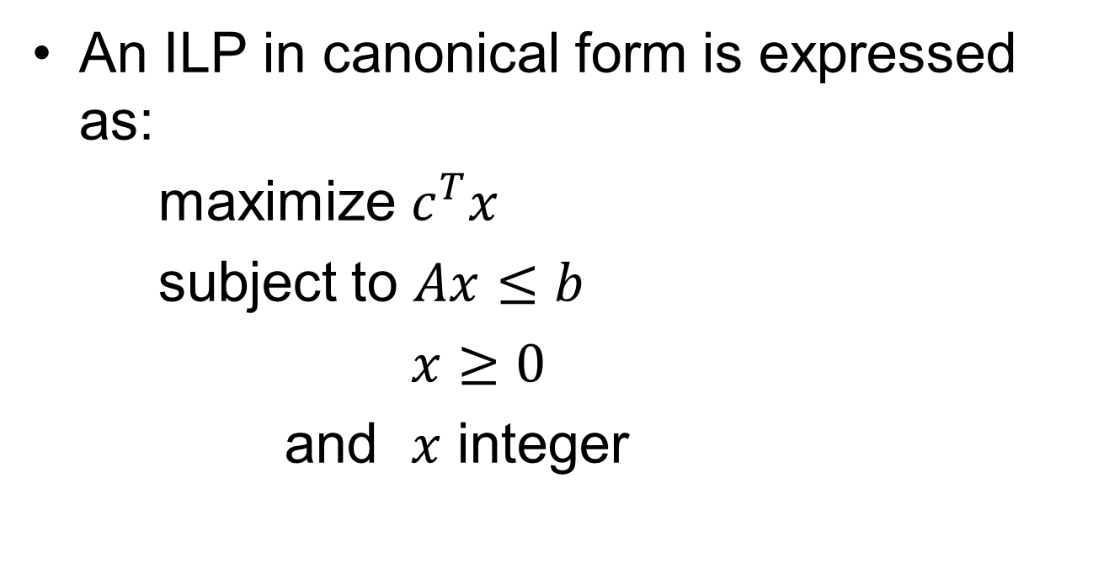
Integer linear programming (NP-hard)
An ILP in canonical form is expressed as:
maximize $c^{T}x$
subject to $Ax≤b$
$x≥0$
and $x$ integer

Slide 7
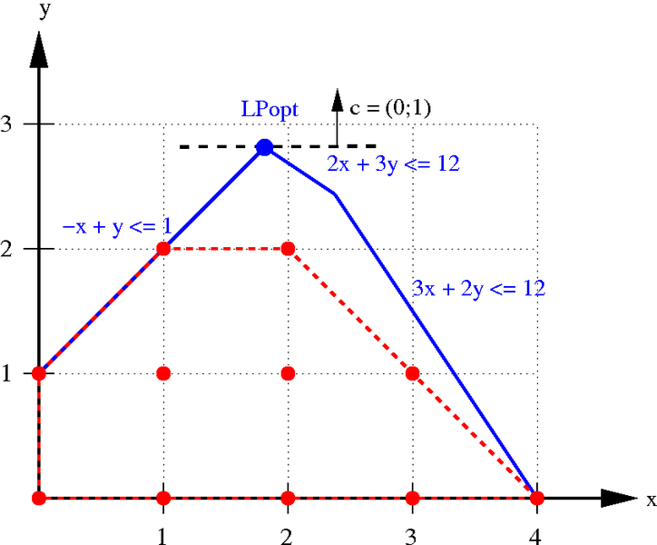
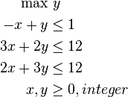
Integer linear programming (NP-hard)
An example:

Slide 8
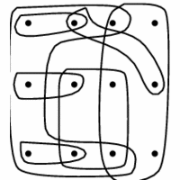
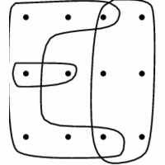

Set cover problems (NP-hard)
Given a set of elements $\text{\{1,2, … , }\text{n}\text{\}}$ (called the universe) and a set $S$ of $m$ sets whose union equals the universe, the set cover problem is to identify the smallest subset of the union of which contains all elements in the universe.

Slide 9
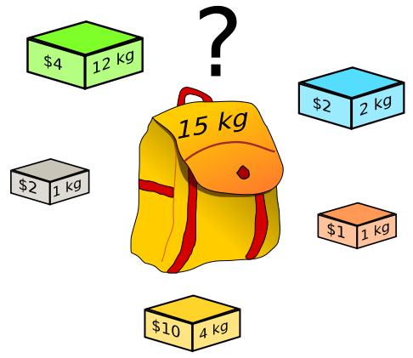
Knapsack problems (NP-hard)
Given a set of items, each with a weight and a value, determine the number of each item to include in a collection so that the total weight is less than or equal to a given limit and the total value is as large as possible.
Backtracking Algorithm

Slide 10
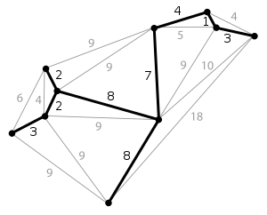
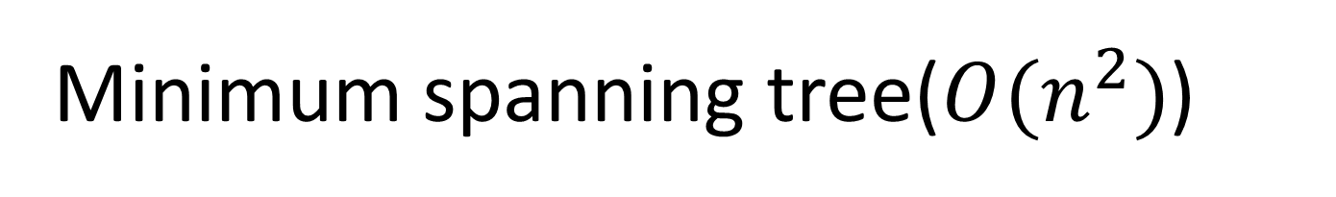
Minimum spanning tree($O(n^{2})$)
A minimum spanning tree (MST) is then a spanning tree with weight less than or equal to the weight of every other spanning tree.
Kruskal's algorithm (greedy Alg.)

Slide 11
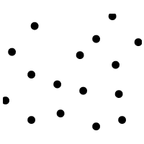
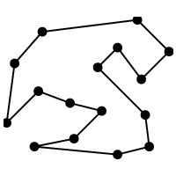
Traveling salesman problem (NP-hard)
The travelling salesman problem (TSP) asks the following question: given a list of cities and the distances between each pair of cities, what is the shortest possible route that visits each city exactly once and returns to the origin city?

Slide 12
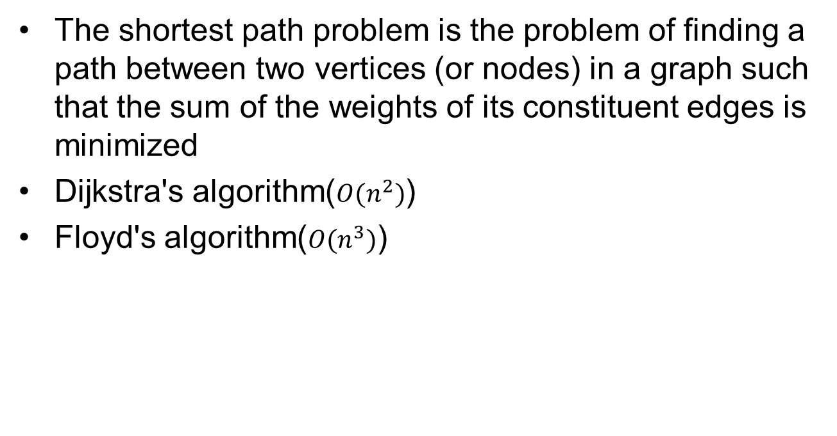
Shortest path problem
The shortest path problem is the problem of finding a path between two vertices (or nodes) in a graph such that the sum of the weights of its constituent edges is minimized
Dijkstra's algorithm($O(n^{2})$)
Floyd's algorithm($O(n^{3})$)

Slide 13
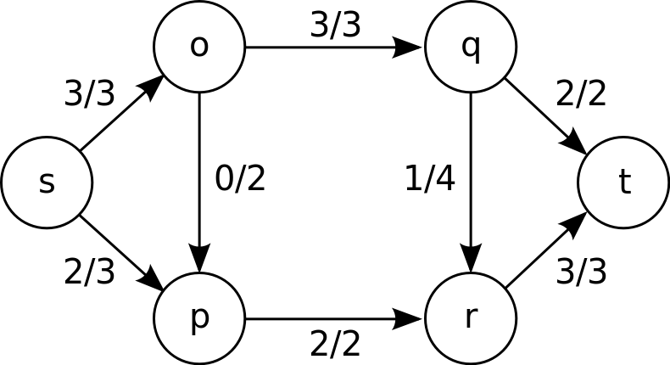
Maximum flow problem (NP-hard)
Maximum flow problem is to find a feasible flow through a single-source, single-sink flow network that is maximum
Max-flow min-cut theorem

Slide 14
Uses of Discrete Optimization
Resource managment
Supply Chain
Off-shore oil drilling infrastructure planning
Medical
Computational molecular biology
Pharmaceutical testing schedules
Radiation Treatment Planning
Medical Imaging

Slide 15
Radiation for Cancer Treatment
Types
Photons (x-rays and γ-rays)
Protons
Delivery
External beam
Intensity Modulated Radiation Treatment (IMRT)
Gamma Knife
Brachytherapy (seeds)

Slide 16
Goals of Radiation Therapy
50% isodose line coverage of the target volume
Minimize the non-target volume covered by external beams
Minimize dose to near-by sensitive structures
Minimize the number of shots → maximize the number of treated patients
Simplicity

Slide 17

Optimization
Calculate Dose (Gy) to each voxel (x,y,z) in the target volume and surrounding volume
U_{R} – Threshold dose
M – contant
R – target region
β_{R} – percent over-dose allowed (tolerance)
Exceed – binary varaible
Mixed Integer Programming to solve

Slide 18
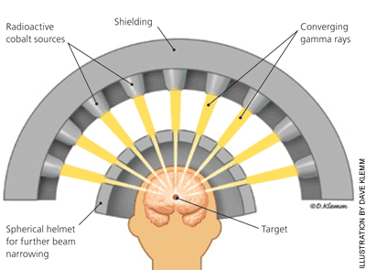
Gamma Knife Radio-surgery
Co-60 source emits gamma rays by radioactive decay
Allows for much fewer fractions of radiation
Main application to brian tumors
Delivered in several “shots” – time and weight are controlled
Notes:
All the beams point to the same point and create a sphere of dose distrubution

Slide 19
Gamma Knife Optimization
Two steps to optimization
Continuous variables optimized using quassi-Newton method
position and weight of shots
Discrete variables optimized using simulated annealing
number of shots and collimator size

Slide 20
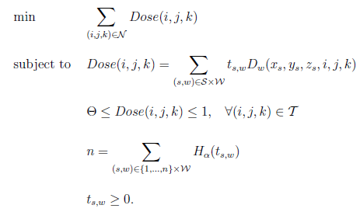
Gamma Knife Optimization
Mixed Integer Programming
Very large solution space
Notes:
x,y,z sub-s – coordinate of the center of the shot
n shots – H sun alpha – Heavyside step function to smooth the binary variable
W – discrete collimator sizes
t sub s,w – time of shot s with wight w
D sub w – dose at a voxel I,j,k from shot centered at x,y,z sub s
Theta = prescribed dose to volume
T – taget
If fixed shot cordinate, then this becomes a linear problem, otherwise it is non-linear

Slide 21
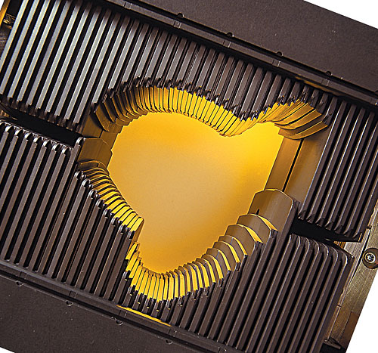
IMRT

Slide 22
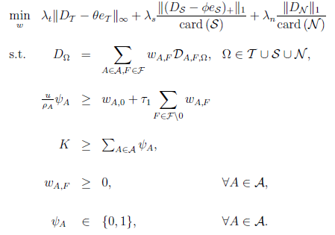
IMRT
Mixed Integer Programming
Optimize beam angles, wedge orientations, beam intensities
Long run time to solve

Slide 23

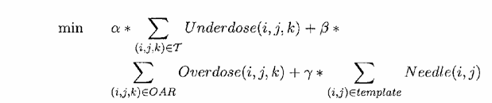
Brachytherapy Optimization
Subject to constraints related to limiting needles to place the seed, limited dose to sensitive organs
Mixed integer programming and branch-and-bound methods

Slide 24
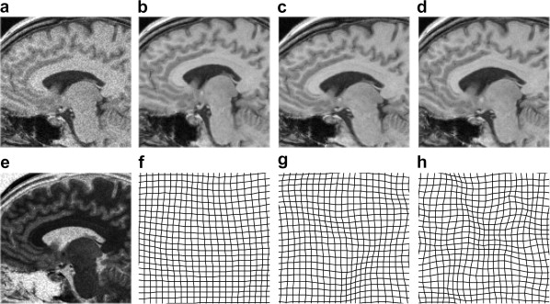
Discrete Optimization in Medical Imaging
Glocker B, Komodakis N, Tziritas G, et al. Dense image registration through MRFs and efficient linear programming. Medical Image Analysis 2008;12:731-741

Slide 25
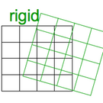
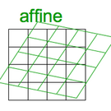
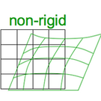
Basics of Image Registration
Images must be registered in order to compare multiple subjects in a group
From the most simple to the most complex:
Rigid
Affine
Non-rigid
Varying DOF

Slide 26
Why does medical imaging need optimization?
Curse of Dimensionality
1 million + voxels
Curse of non-convexity
Ill-posed problem (more parameters than constraints)
Curse of non-linearity
Not all registrations are affine
Curse of modularity
Solutions for very specific problems

Slide 27
What have they already tried?
Powell’s (conjugate direction) method
Downhill Simplex
Levenberg-Marquardt
Currently used by SPM8
Newton-Raphson
Stochastic search methods
Gradient descent methods
Quasi-exhaustive search methods

Slide 28
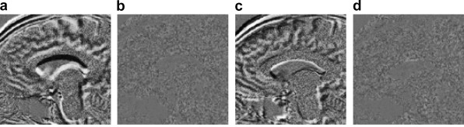
What’s going on now?
Glocker et al. recently published a paper using discrete optimization techniques for image registration
Model registration as Markov Random Field
MRF is optimized using the primal-dual schema
Performs well on MRI brain image registration
Glocker B, Komodakis N, Tziritas G, et al. Dense image registration through MRFs and efficient linear programming. Medical Image Analysis 2008;12:731-741

Slide 29
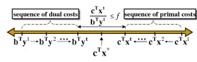
The Primal-Dual Schema
Main goal: Minimize gap between the primal and dual costs
Primal problem is NP hard

Slide 30
Estimating Biomarkers
Once the images are registered discrete optimization is also being used to find biomarkers related to the imaging data
Biomarker = an indicator of a biological state
Optimization helps with the curse of non-convexity
Not much literature on this yet
Jobs?

Slide 31
Bipartite Matching
A graph G = (V,E) consists of a set V of vertices and a set of E of pairs of vertices called edges.
An edge e = (u,v)
A graph is bipartite if the vertex set V can be partitioned into two sets A and B such that no edge in E has both endpoints in the same set of the bipartition.
A matching is perfect if no vertex is exposed

Slide 32
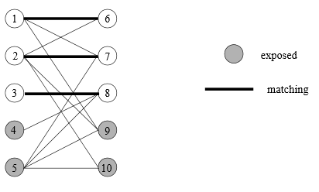
Bipartite Matching
There are three edges
(1,6)
(2,7)
(3,8)

Slide 33
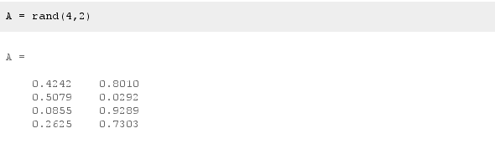
Bipartite Matching
Consider a rectangular matrix A of random numbers
Determine the matching
mi = [2;3]
mj = [1;2]

Slide 34
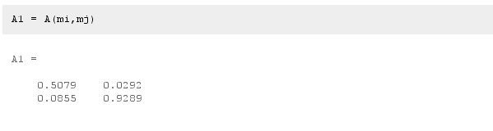
Bipartite Matching
Rearrange the matrix based on the outputs of the previous problem

Slide 35
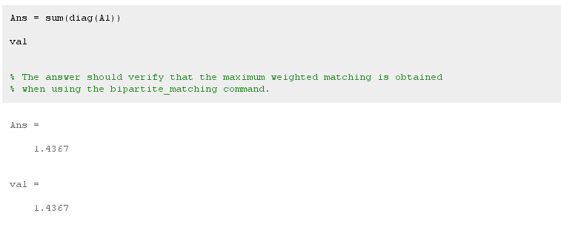
Bipartite Matching
Sum the diagonal of the new matrix

Slide 36
References
wikipedia.org
http://www.cs.sunysb.edu/~algorith/implement/syslo/implement.shtml
Glocker B, Komodakis N, Tziritas G, et al. Dense image registration through MRFs and efficient linear programming. Medical Image Analysis 2008;12:731-741
Varian.com
Aafp.org

